Slide 1


CHAPTER 3
Research Design
DISCOVER . LEARN . EMPOWER

Slide 2
INDEX
Randomized Block
Completely Randomized Block
Latin Square, Factorial Design
Types
Formulation of Hypothesis
Feasibility
Preparation and Presentation of Research Proposal

Slide 3
Randomized Block
It is an improvement over the C.R. design.
In the R.B. design the principle of local control can be applied along with the other two principles of experimental designs.
The main feature of the R.B. design is that in this each treatment appears the same number of times in each block. The R.B. design is analysed by the two-way analysis of variance (two-way ANOVA)* technique.

Slide 4
Completely randomized design (C.R. design)
Involves only two principles viz., the principle of replication and the principle of randomization of experimental designs. It is the simplest possible design and its procedure of analysis is also easier. The essential characteristic of the design is that subjects are randomly assigned to experimental treatments (or vice-versa)

Slide 5
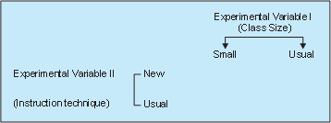
(i) Two-group simple randomized design
In a two-group simple randomized design, first of all the population is defined and then from the population a sample is selected randomly. Further, requirement of this design is that items, after being selected randomly from the population, be randomly assigned to the experimental and control groups.

Slide 6
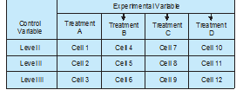
(ii) Random replications design
The limitation of the two-group randomized design is usually eliminated within the random replications design. In the illustration just cited above, the teacher differences on the dependent variable were ignored, i.e., the extraneous variable was not controlled. But in a random replications design, the effect of such differences are minimised (or reduced) by providing a number of repetitions for each treatment. Each repetition is technically called a ‘replication’.

Slide 7
Latin square design (L.S. design)
It is an experimental design very frequently used in agricultural research. For instance, an experiment has to be made through which the effects of five different varieties of fertilizers on the yield of a certain crop, say wheat, it to be judged.
In such a case the varying fertility of the soil in different blocks in which the experiment has to be performed must be taken into consideration; otherwise the results obtained may not be very dependable because the output happens to be the effect not only of fertilizers, but it may also be the effect of fertility of soil.
Similarly, there may be impact of varying seeds on the yield. To overcome such difficulties, the L.S. design is used when there are two major extraneous factors such as the varying soil fertility and varying seeds.

Slide 8
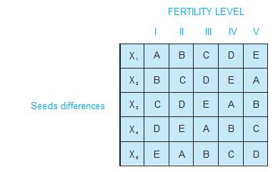
Latin square design (L.S. design)

Slide 9
Factorial designs
Factorial designs are used in experiments where the effects of varying more than one factor are to be determined. They are specially important in several economic and social phenomena where usually a large number of factors affect a particular problem. Factorial designs can be of two types:
(i) simple factorial designs
(ii) complex factorial designs

Slide 10
Simple factorial designs

Slide 11
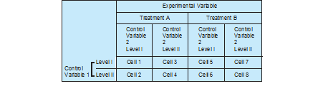
Complex factorial designs

Slide 12
HYPOTHESIS
one simply means a mere assumption or some supposition to be proved or disproved.
But for a researcher hypothesis is a formal question that he intends to resolve.
Thus a hypothesis may be defined as a proposition or a set of proposition set forth as an explanation for the occurrence of some specified group of phenomena either asserted merely as a provisional conjecture to guide some investigation or accepted as highly probable in the light of established facts.

Slide 13
Characteristics of hypothesis
Clear and precise
Hypothesis should be capable of being tested
State relationship between variables
limited in scope and must be specific
Stated as far as possible in most simple terms so that the same is easily understandable by all concerned
Hypothesis should be consistent with most known facts
Hypothesis should be amenable to testing within a reasonable time
Hypothesis must explain the facts that gave rise to the need for explanation

Slide 14
BASIC CONCEPTS CONCERNING TESTING OF HYPOTHESES
(a) Null hypothesis and alternative hypothesis
Alternative hypothesis is usually the one which one wishes to prove and the null hypothesis is the one which one wishes to disapprove.
(b) The level of significance: This is a very important concept in the context of hypothesis testing. It is always some percentage (usually 5%) which should be chosen wit great care, thought and reason.

Slide 15
BASIC CONCEPTS CONCERNING TESTING OF HYPOTHESES
(c) Decision rule or test of hypothesis: Given a hypothesis H₀ and an alternative hypothesis Ha, we make a rule which is known as decision rule according to which we accept H₀ (i.e., reject Ha) or reject H₀ (i.e., accept Ha). For instance, if (H₀ is that a certain lot is good (there are very few defective items in it) against Ha) that the lot is not good (there are too many defective items in it), then we must decide the number of items to be tested and the criterion for accepting or rejecting the hypothesis. We might test 10 items in the lot and plan our decision saying that if there are none or only 1 defective item among the 10, we will accept H₀ otherwise we will reject H₀ (or accept Ha). This sort of basis is known as decision rule.

Slide 16
BASIC CONCEPTS CONCERNING TESTING OF HYPOTHESES
(d) Type I and Type II errors: In the context of testing of hypotheses, there are basically two types of errors we can make. We may reject H0 when H0 is true and we may accept H0 when in fact H0 is not true. The former is known as Type I error and the latter as Type II error. In other words, Type I error means rejection of hypothesis which should have been accepted and Type II error means accepting the hypothesis which should have been rejected.
(e) Two-tailed and One-tailed tests: In the context of hypothesis testing, these two terms are quite important and must be clearly understood.

Slide 17
PROCEDURE FOR HYPOTHESIS TESTING
(i) Making a formal statement
(ii) Selecting a significance level
(iii) Deciding the distribution to use
(iv) Selecting a random sample and computing an appropriate value
(v) Calculation of the probability
(vi) Comparing the probability

Slide 18
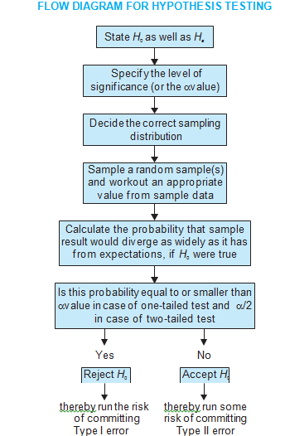
FLOW DIAGRAM FOR HYPOTHESIS TESTING

Slide 19
TESTS OF HYPOTHESES
Hypothesis testing determines the validity of the assumption (technically described as null hypothesis) with a view to choose between two conflicting hypotheses about the value of a population parameter.
Hypothesis testing helps to decide on the basis of a sample data, whether a hypothesis about the population is likely to be true or false.
Parametric tests or standard tests of hypotheses
Non-parametric tests or distribution-free test of hypotheses.

Slide 20
IMPORTANT PARAMETRIC TESTS
z-test
t-test
c² -test
F-test.

